Slide 1
LLM Multi-head Attention Pruning
Determining the Impact of Multi-head Attention Pruning On Large Language Models
Welby Seely

Slide 2
What have I worked on this semester?
The initial aim this semester was to comprehensively understand methodologies for determining neuron sensitivity in large language models (LLMs) and explore improvements.
Conducted a literature review, revealing that research tends to:
Be narrowly focused.
Lack a unified framework for analyzing neuron sensitivity holistically
Focus on singular metrics, like perplexity, leaving out metrics like evaluation time and energy consumption.
Began building a framework for performing this holistic analysis, systematically capturing metrics across the model’s architecture.
The first component supported by this framework is the Multi-head Attention mechanism, the core innovation of the Transformer network.

Slide 3
Limitations of State-of-the-Art Research
Example research from initial literature review:
Llm-pruner: On the structural pruning of large language models (Xinyin Ma et al., 2023)
LLM Pruning and Distillation in Practice: The Minitron Approach (Sreenivas et al., 2024)
Everybody Prune Now: Structured Pruning of LLMs with only Forward Passes (Dery et al., 2024)
A Simple And Effective Pruning Approach For Large Language Models (Sun et al., 2024)
Large Language Model Pruning (Huang et al., 2024)
Limitations include:
Lack of ability to prune arbitrary heads.
No measurement of per-token execution time and energy consumption.
Lack of support for models using Grouped Query Attention (like Llama 3).
Narrow focus on specific types of optimizations.
Ex: pruning vertical parameter “channels” consisting only of zeroed weights.

Slide 4
Proposal: A Holistic Framework
A structured framework is necessary to evaluate LLM components systematically
This framework should:
Be able to analyze the systemic effects of approximating arbitrary components (e.g. attention heads, embedding layers).
Include comprehensive resource and performance metrics.
Perform parameter importance analysis within and between components.

Slide 5
An Experimental First Step: Attention Head Pruning
Implemented attention head pruning framework, initially targeting the Llama 3 Decoder architecture.
Prunes attention heads on a per layer basis.
This includes key and value heads when orphaned by a pruned attention head.
Calculates averaged sensitivity scores compared against an unpruned model.
This helps characterize the sensitivity of each layer to changes to its attention mechanism.

Slide 6
Experimental Test Setup
Model: Llama 3 8b
32 layers
32 attention heads per layer
Test Data: wikitext-2-v1
A collection of over 100 million tokens extracted from the set of verified Good and Featured articles on Wikipedia.
Evaluated each layer with batch size of 5 across 25 prompts.
Executed on an Nvidia RTX 4090.
Tests executed over SSH
Desktop environment disabled
Validated that Python was the only process accessing the GPU through the Nvidia System Management Interface
4 metrics collected, all compared against a baseline (unpruned model):
Per layer perplexity
Energy usage per token
Evaluation time per token
Allocated Memory

Slide 7
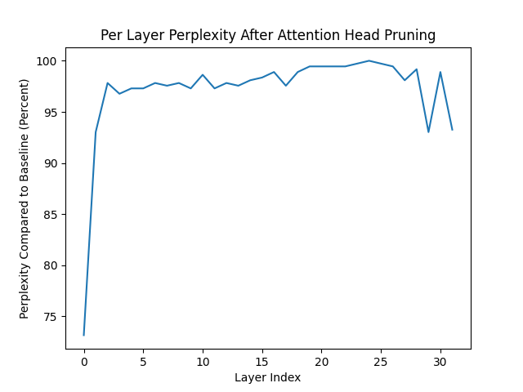
Per Layer Perplexity

Slide 8
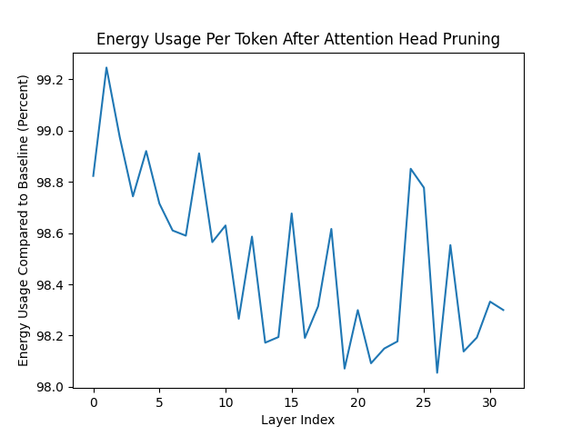
Energy Usage Per Token

Slide 9
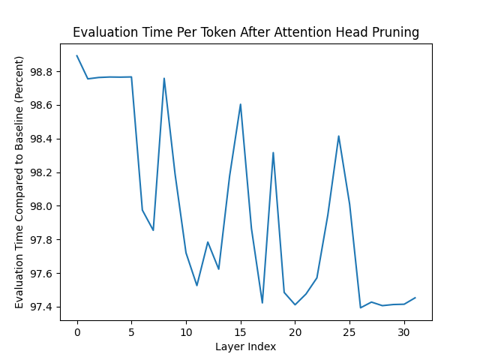
Evaluation Time Per Token

Slide 10
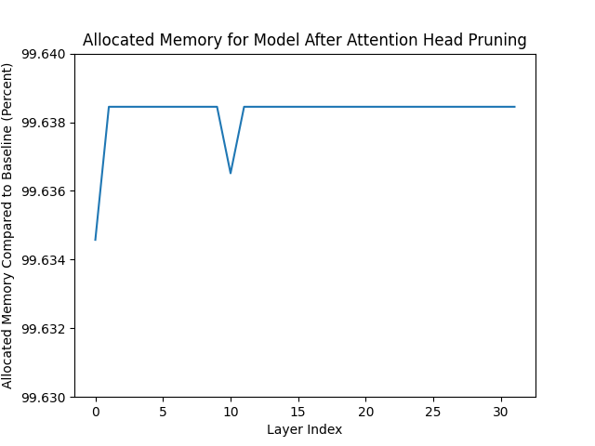
Allocated Memory

Slide 11
Next Steps
Enable pruning heads based on different strategies, including:
Random pruning
Gradient based pruning
Magnitude Based Pruning
Measure the effects Progressive Pruning
Incrementally prune heads in one layer (e.g., prune 25%, 50%, 75%) to measure the cumulative effect
Using these strategies, generate a heatmap of individual heads in each layer
Enable pruning of additional components (e.g. the MLP in each Decoder block).

Slide 12
Github and Questions
https://github.com/crimsonmagick/llm-approximation
Questions?

